Slide 1

DriverPass System Analysis
Vincent Snow
Notes:
[No speaker notes required for this slide.]

Slide 2

System Requirements
Will allow students to view class material and take practice exams
Will allow students to make appointments for driving lessons online and secretary to edit the schedule.
Will not require server maintenance manually by the DriverPass IT admin.
Will be able to handle multiple users logged in at once without affecting performance.
Notes:
The nonfunctional requirements here are that the system will not require server maintenance and will be able to handle multiple users logging in at once. DriverPass wants to focus on the operation of their business and not be interrupted by the need to maintain and update the server themselves; they also would like to serve multiple students and employ many drivers who may need to log on simultaneously.
The functional requirements here are that the students will be able to view class material and exams, and that both students and secretary will be able to make appointments for driving lessons. The owner would like students to be able to make appointments online as well as call the secretary to change the schedule when they are away from their computers and, for example, need to cancel an appointment.

Slide 3
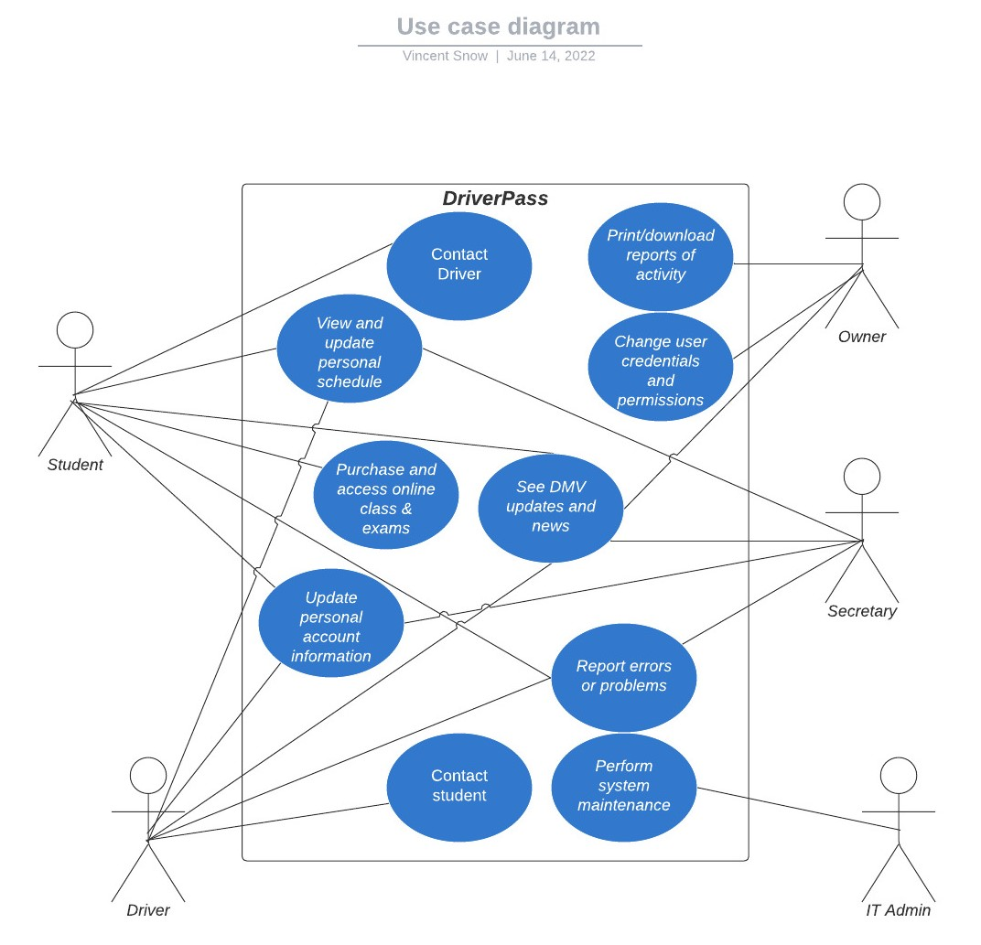
Use Case Diagram
Notes:
The diagram shows the ways that the student, admin, owner, driver, and secretary will interact with the system. The students are the customers who will need to order packages, view their classes, take exams, make appointments for driving lessons, and update their information. Drivers employed by DriverPass will need to see and sometimes edit their schedule as well as contact the students. The IT admin will do any technical work needed (though most updates and maintenance will be handled by the cloud server). The secretary will be able to edit the driving lesson calendar, and the owner will be the only one who can see reports of activity on the system and change other user's username and password. All users will be able to update their personal information and passwords, see DMV updates, and report problems with the web application.

Slide 4
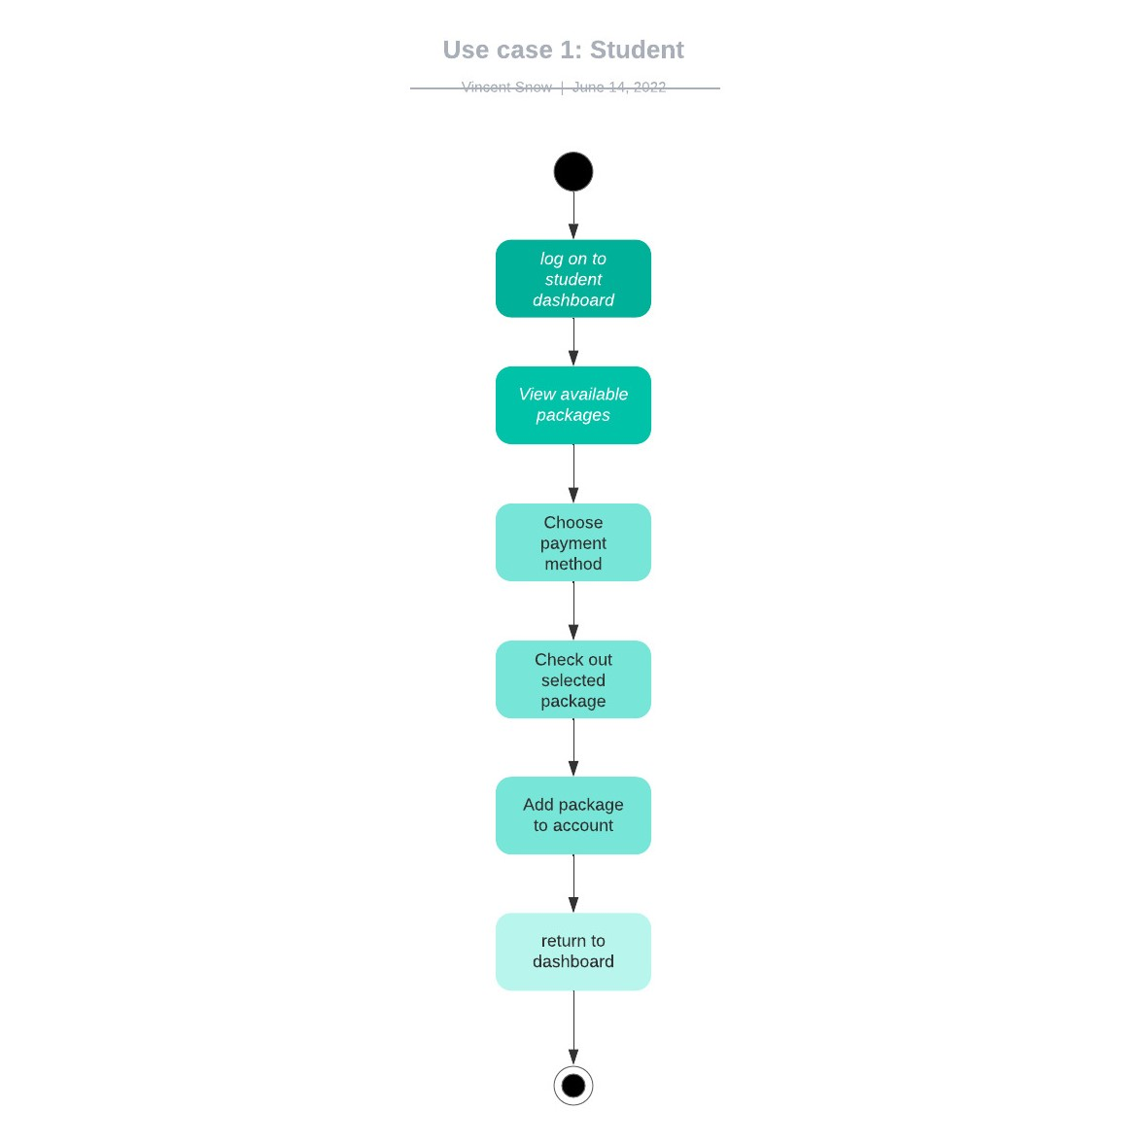
Activity Diagram
Notes:
This diagram shows a situation where a student is trying to purchase a DriverPass package of class and driving lessons. After following these steps, the system will update that student's account with the package they have purchased and track progress so that they can use their dashboard to view the material or make appointments. The checkout process will be simple and allow for the purchase of one package at a time, with choice of payment method, and return them to the dashboard once finished.

Slide 5
Security
A unique username and password are required for all users to log in.
Passwords must be between 6-12 characters to make them difficult to guess with brute-force hacking and prevent accidental or intentional server space overloading.
An email is required for all accounts; this will be a secure way to send a password reset confirmation if the password is forgotten.
Notes:
Each type of user will have their own dashboard where they can access different parts of the system and do things within their permissions. To be sure no users are confused, each one will need a unique username and password. The passwords will be restricted to a certain length, this is to prevent accidents or malicious attacks that could crash the server or drive up the cost of hosting unnecessarily and make the passwords hard to guess for hacker's tools that try random combinations of characters. When a user forgets their password, an automated email can be sent to them to reset it, so that no one else can try to change or see their password.

Slide 6
System Limitations
Must fit into the budget for cloud server, database and file hosting
Must be operable and ready to launch by the deadline
Students must have access to the internet on a PC or tablet.
Notes:
The cloud server hosting for the application will cost money and need to fit into a budget. The application will be ready to serve customers by the deadline. The system will be usable by students only on tablet and PC devices, as a mobile phone is not an appropriate size for viewing the application. It will not be available offline.

